Slide 1

can we improve CHRONIC DISEASE IN AMERICA? Presented by: Lydia Thielen NSS Data Analytics Cohort 14
Notes:
Hello my name is Lydia Thielen, data analyst student at NSS. I am going to talk about chronic disease in America. I came into USA 15 years ago and I have personally experienced that eating highly processed food, typical American diet full of carbs and unnatural artificial colors are very inflammatory, can increase allergies, sometimes even causing anaphylactic shocks. Since my family has changed a typical American lifestyle into a healthier one such as Keto/Carnivore, we all have gained a mental clarity, focus, calmness, have gotten rid inflammation from our bodies overall at least 90 percent & we are enjoying life without any pain or daily allergy medications. I have chosen this topic because I desire for my family to have a happy and healthy mom, who inspires others to take control over their mental & physical health, to be healthy again

Slide 2

Goals and objectives
Cost of Chronic Disease
4 Chronic Disease Categories
Learning Disabilities in Kids
3 Risk Factors
Recommendation

Slide 3

DATA & Explanations
National Health Expenditure 1960- 2022
Highest States in Chronic Diseases
Risks Factors Effect on States
Percentage of Learning Disabilities in Kids
Notes:
My focus in this data analysis is data from CDC, FDA, and data from National Center of Education Statistics.

Slide 4
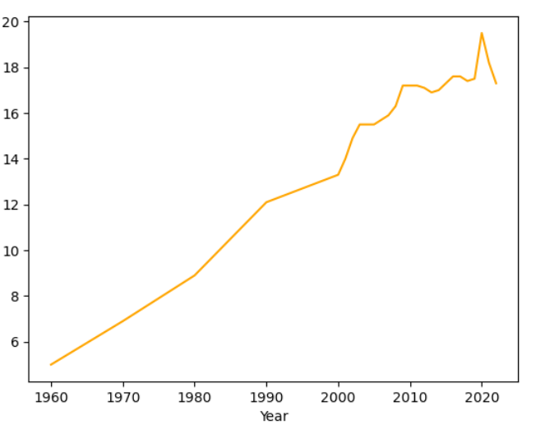
National Health Expenditure by percent grew 4.1% in 2022 to $4.5 trillion or $13,493 per person, and accounted for 17.3% of Gross Domestic Product
Notes:
Chronic diseases are the leading causes of illness, disability, and death in the United States. NHE grew 4.1% to $4.5 trillion in 2022, or $13,493 per person, and accounted for 17.3% of Gross Domestic Product

Slide 5
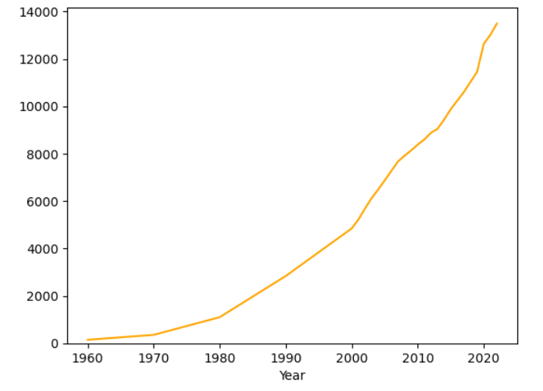
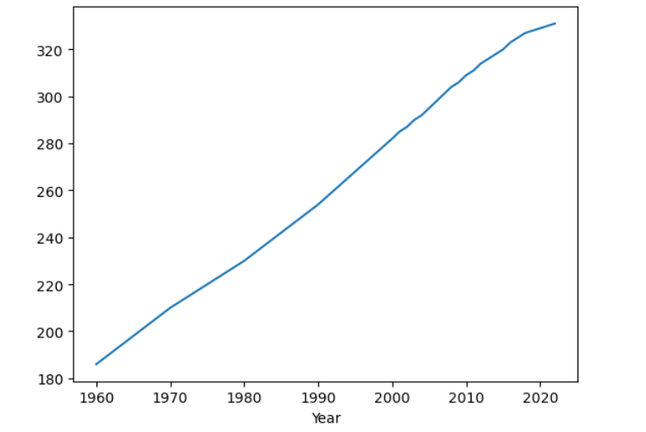
Nh expenditure VS population GROWTH
Notes:
As you can see from the graph on the left, yearly expenditure per person has been increasing more dramatically than the USA population on the right.
$13,493 per person in 2022, and in 2022 we had 331 million of people

Slide 6

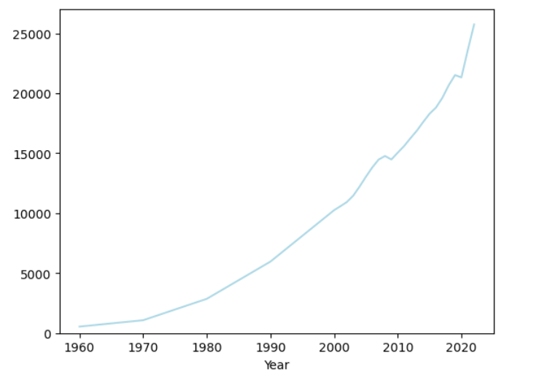
National Healthcare Expenditure GDP 1960- 2022
Notes:
In 1960 GDP was 542 billion and it has increased to 25 trillion in 2022. “Ninety percent of the nation's $4.5 trillion in annual health care expenditures are for people with chronic and mental health conditions.

Slide 7
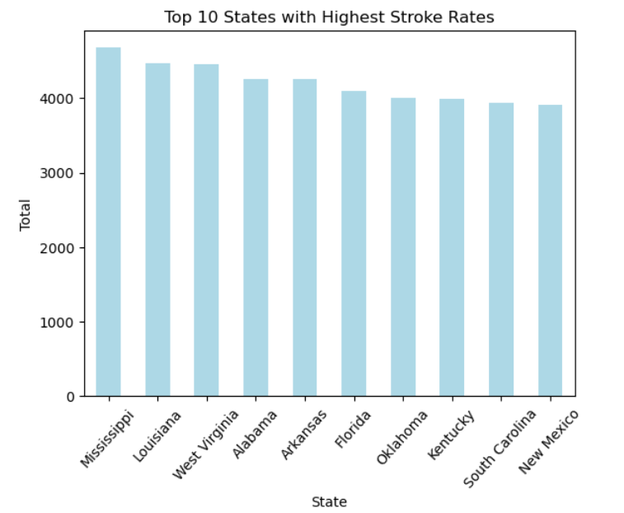
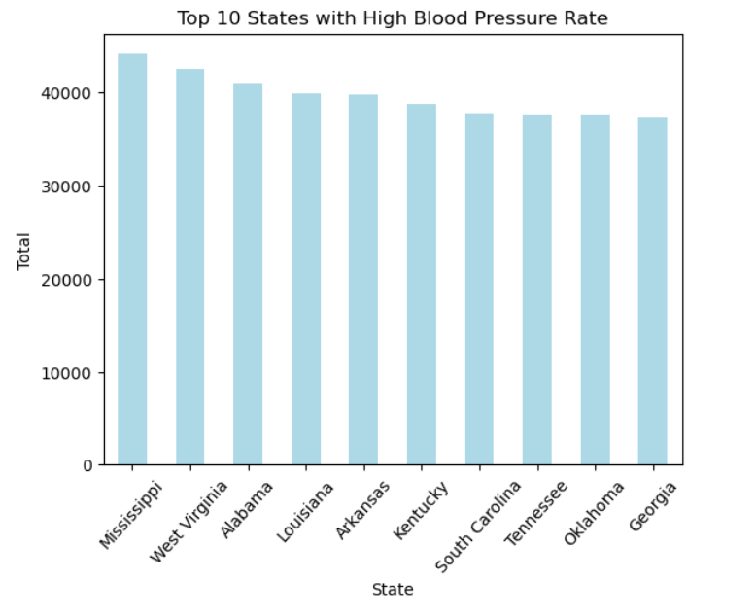
Heart disease
“More than 944,800 Americans die of heart disease or stroke every year—that's more than 1 in 3 deaths” CDC
Notes:
First Category of Chronic Disease is a Heart Disease Category. Leading States for HBP & Stroke are: …. Mississippi is number one state of both categories and TN is place on 7th place out of 50 states.

Slide 8
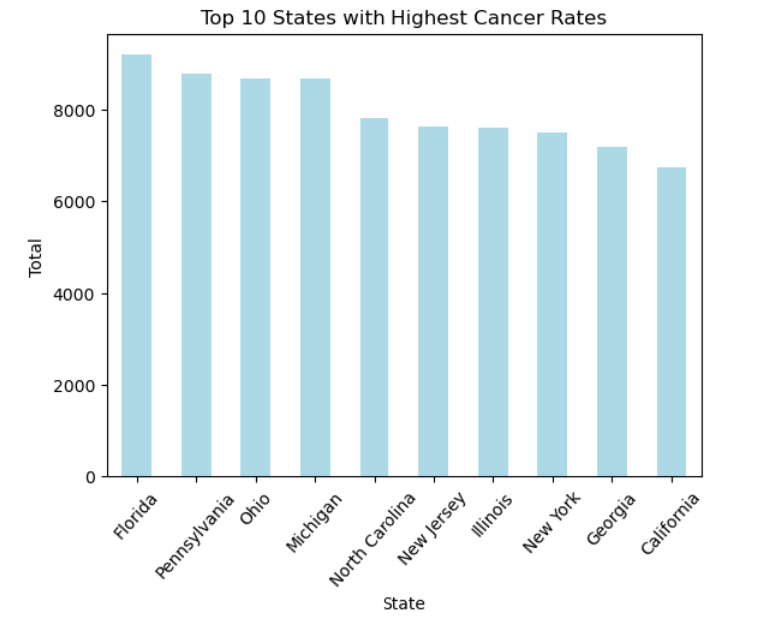
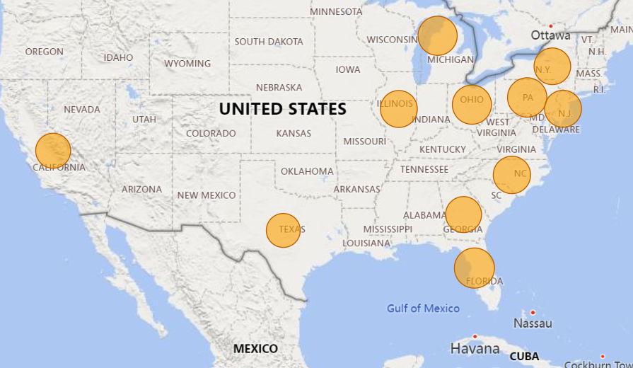
Cancer (non-skin) or Melanoma
Each year 1.7 million people are diagnosed

Slide 9
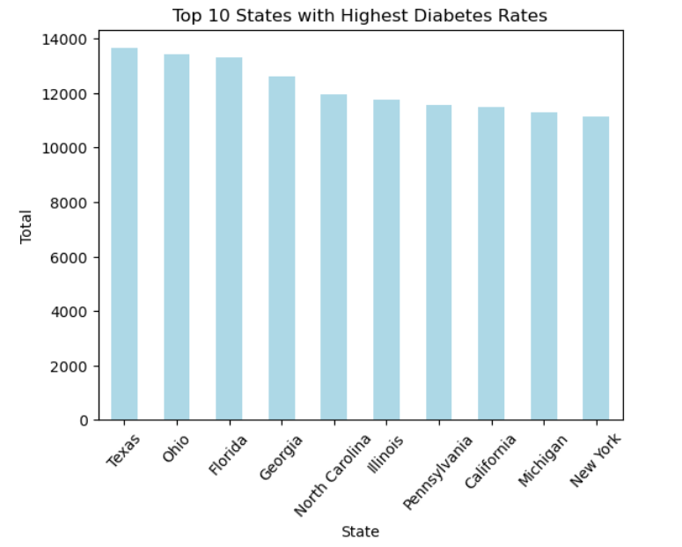
Diabetes
12% of the us population
Notes:
12% = 39,000,000

Slide 10
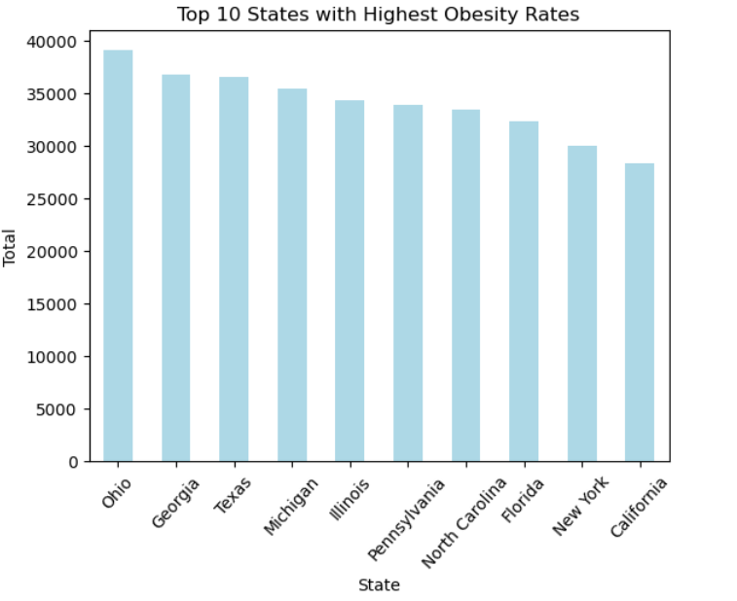
Obesity
“Affects 20% of children and 42% of adults, putting them at risk of chronic diseases such as type 2 diabetes, heart disease, and some cancer” (CDC)

Slide 11
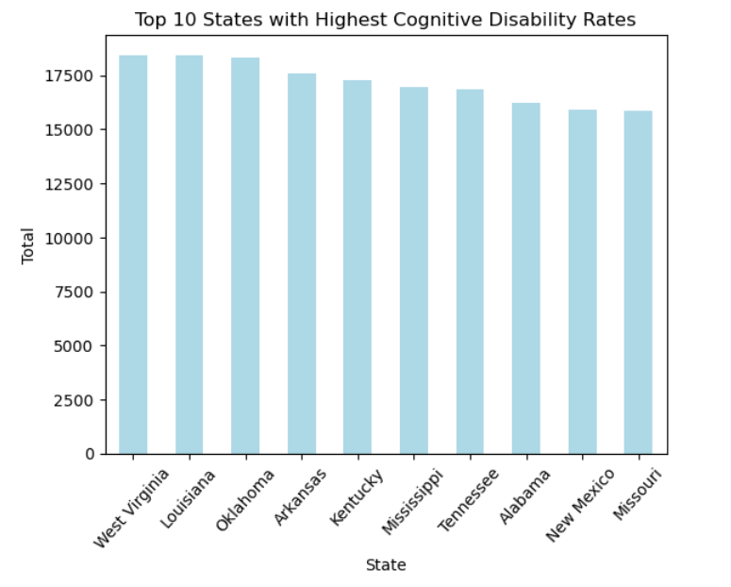

Cognitive disability
emerged as the most prevalent disability in the United States in 2022, affecting 13.9% of adults.
Notes:
West Virginia 18435 , Louisiana 18418 , Oklahoma 18313, Arkansas 17559 , Kentucky 17269, Mississippi 16976, Tennessee 16853

Slide 12

Learning Disabilities in kids “The number of students ages 3–21 who received special education services under the Individuals with Disabilities Education Act (IDEA) was 7.2 million, or 15 percent of all public school”
Notes:
“The number of students ages 3–21 who received special education services under the Individuals with Disabilities Education Act (IDEA) was 7.2 million, or 15 percent of all public school. 32 % of those disabilities were specific learning disabilities

Slide 13
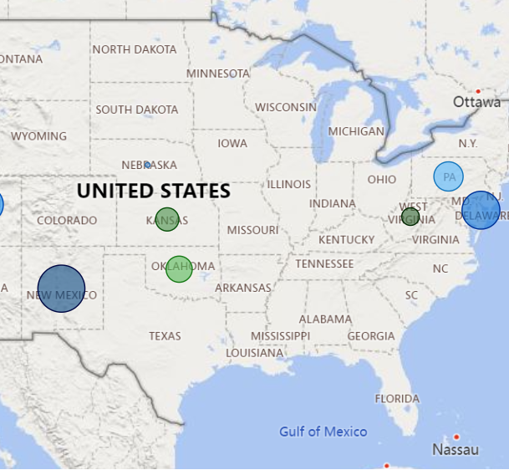
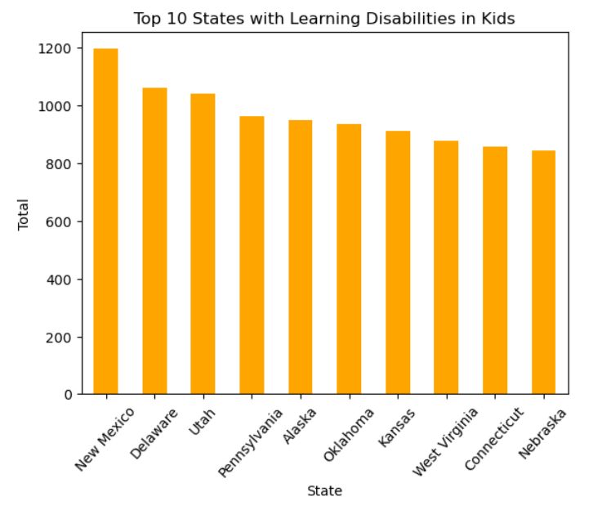
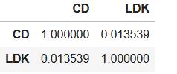
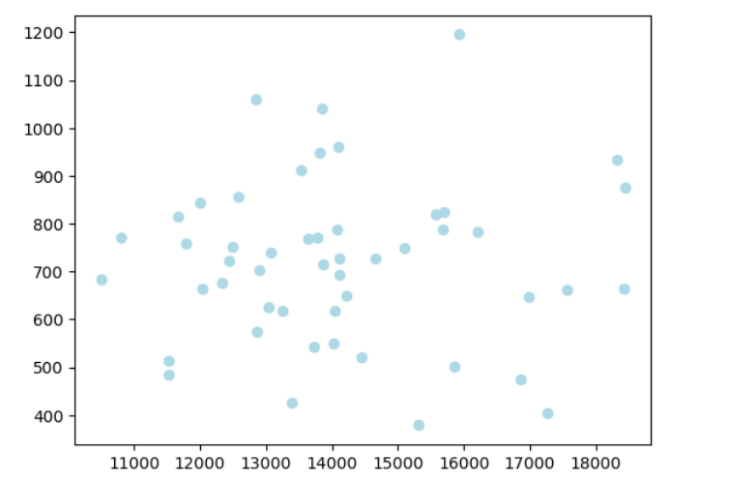

Slide 14
Risk Factors
Cigarette smoking
Physical inactivity
Excessive alcohol use

Slide 15
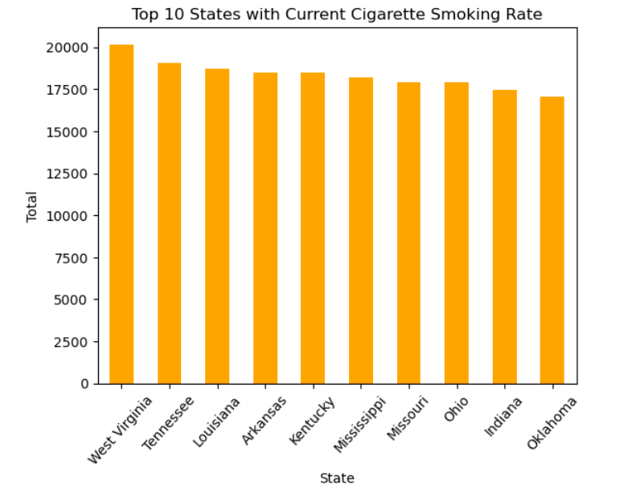
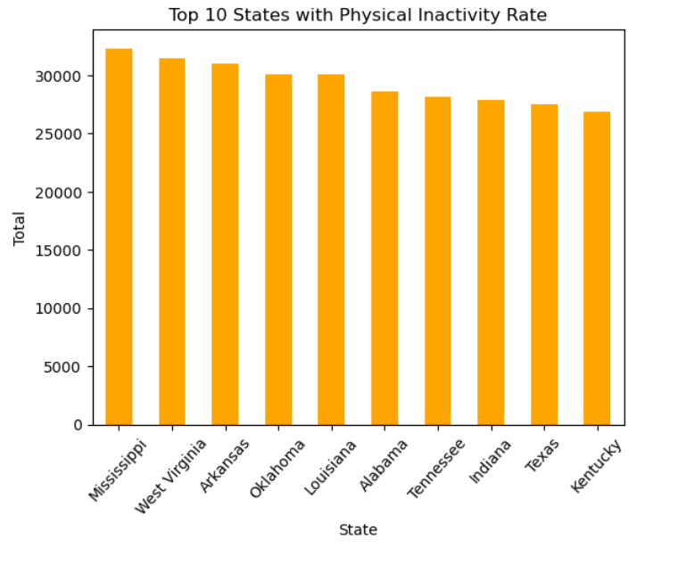

Slide 16
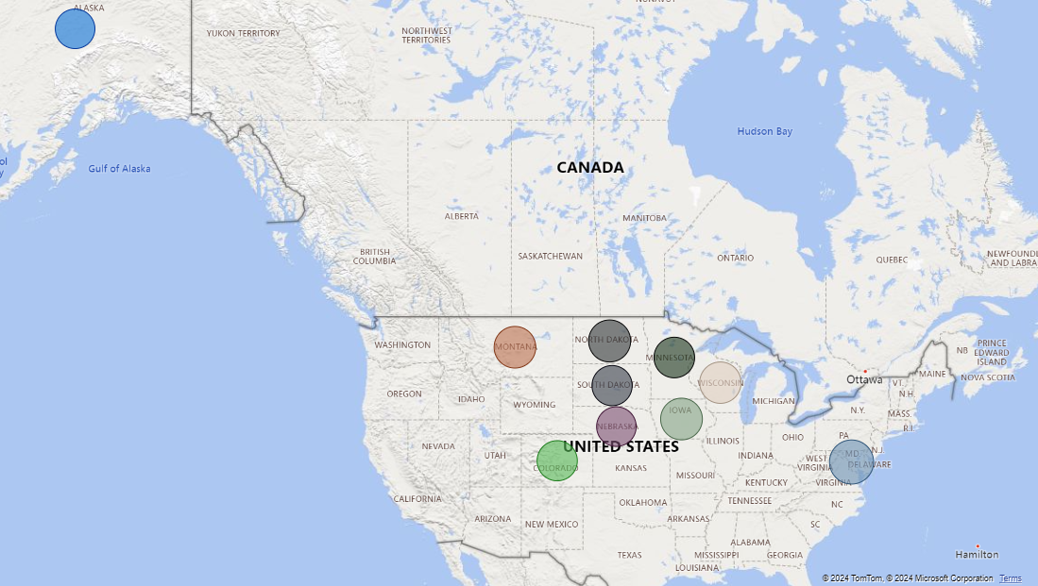
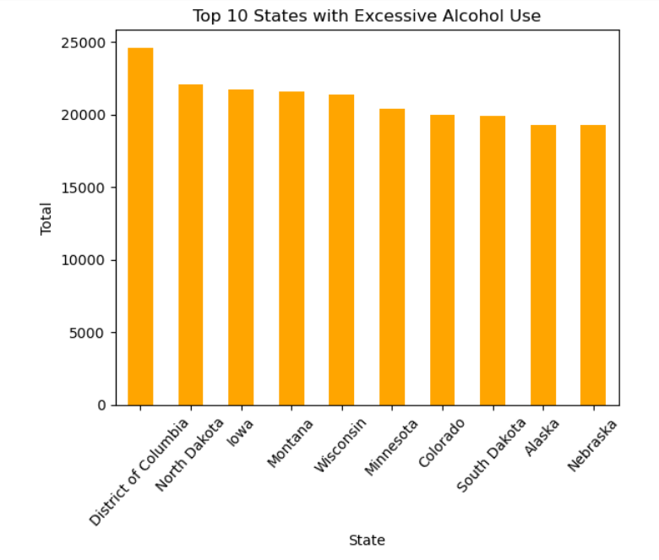
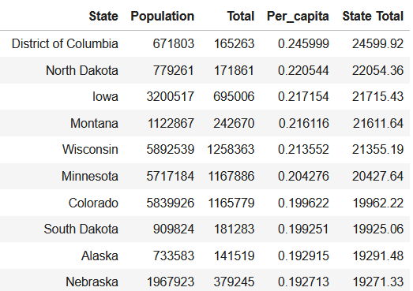

Slide 17
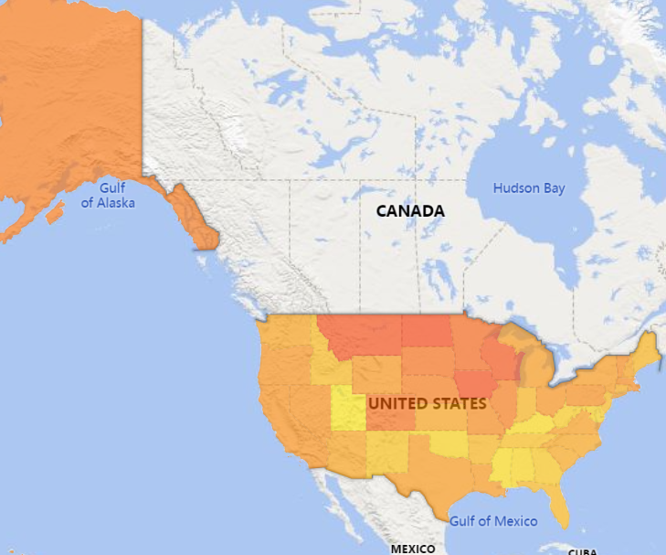
Excessive alcohol

Slide 18
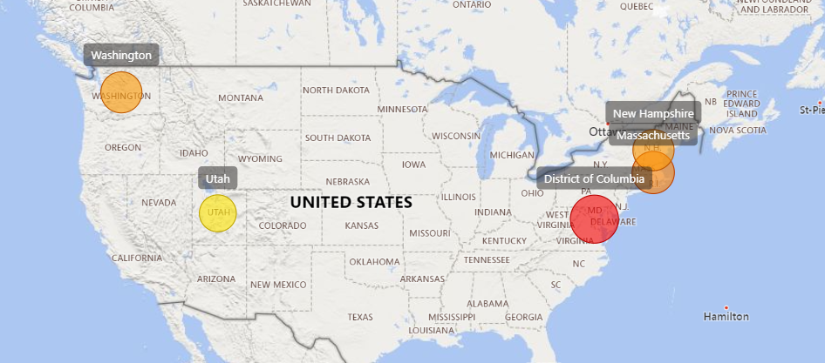
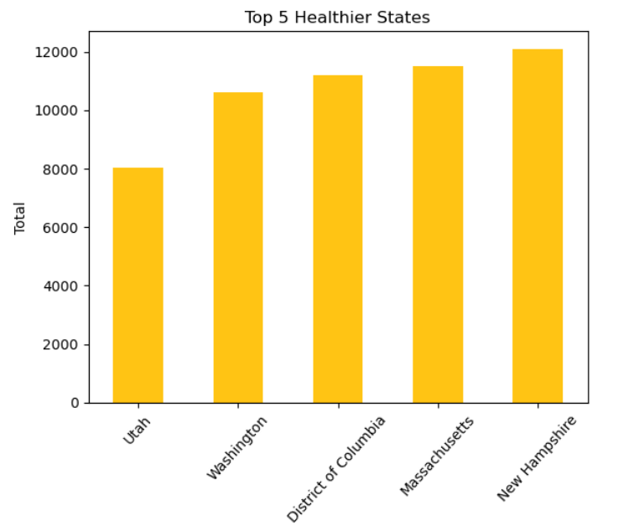
Healthier states

Slide 19
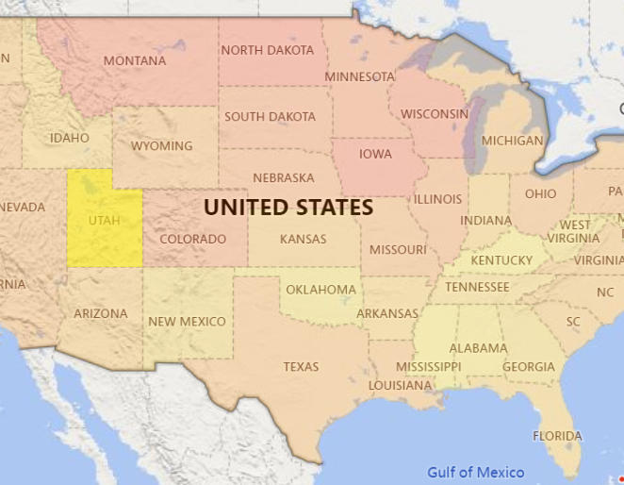
The Healthiest state in the USA in 2022

Slide 20
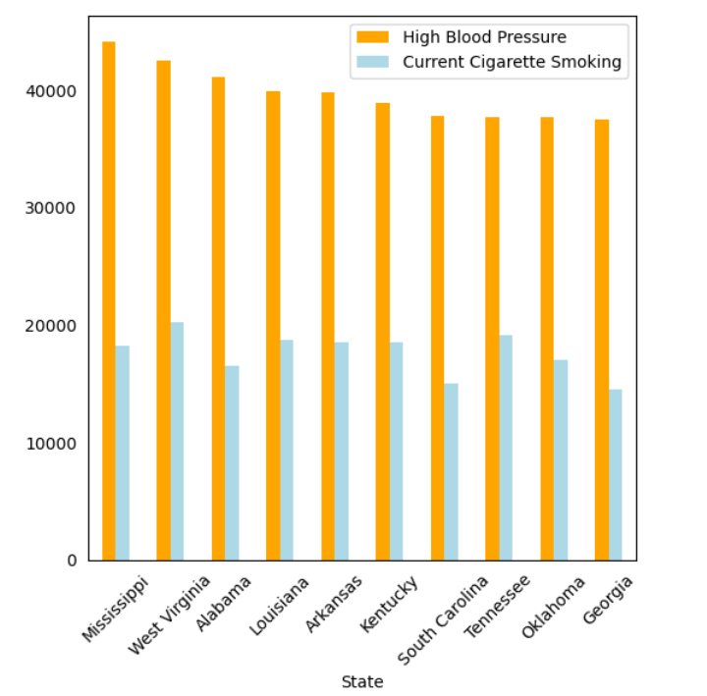
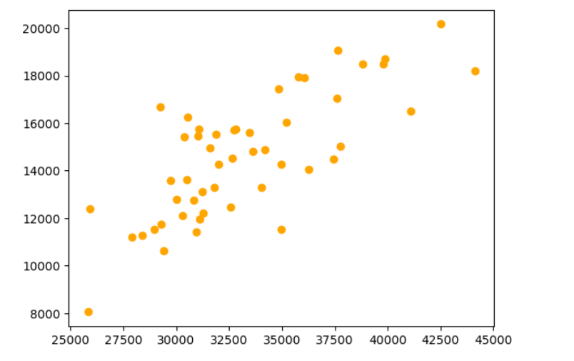
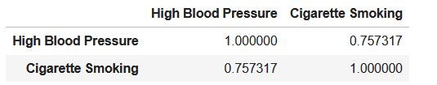
Correlation between smoking and High Blood pressure
Notes:
States with high percentage of smoking are also high in a diabetes category.

Slide 21

What can we do as individuals?
What is your food made? Is it fresh, highly process?
Find community
You can be as successful as you desire to be.
Medical professionals and a healthy community is the key to a success
Make it happen
Educate
Learn
What is making you unwell, what kind of food, drinks, environment?
Notes:
What does CDC recommend? Most chronic diseases are caused by a short list of risk factors: tobacco use, poor nutrition, physical inactivity, and excessive alcohol use. By avoiding these risks and getting good preventive care, you can improve your chance of staying well, feeling good, and living longer.

Slide 22
Websites of medical professionals
https://carnivore.diet/dr-shawn-baker-md/Shawn Baker M.D.
Dr. Shown Baker, The Co-Founder of Rivero, orthopedic surgeon, world leading authority on treating disease with medical nutritional therapy, an Amazon best-selling author, world champion athlete, international speaker, podcast host, and consultant.
www.drberry.com
Dr. Ken Berry, family physician, Tennessee. For over two decades, he has committed to helping patients overcome obesity, insulin resistance, and type 2 diabetes.
https://thesmhp.org/stay-off-my-operating-table-philip-ovadia-md/
Dr. Philip Ovadia – cardiac surgeon, Florida

Slide 23

Thank you
Contact:
ltjthielen@gmail.com
www.linkedin.com/in/lydia-thielen
www.github.com/lyduska

